Slide 1

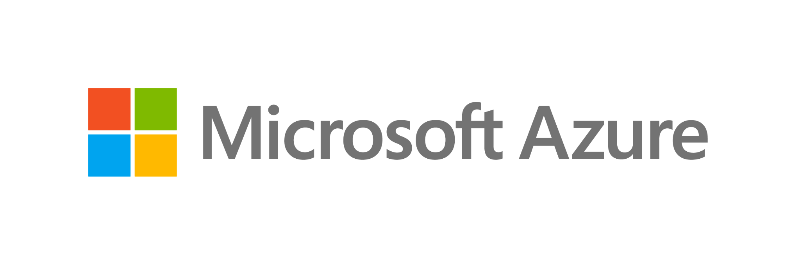
Bank of Baroda Hackathon - 2022
Technology Partner
TECHNO WIZARDS
NISHANTHINI T V
SUBIKSHA N
SURIYA B S
SRISUDHAN L
Date : 19.09.2022

Slide 2
Automated Cheque Processing
For any bank, Cheque clearing is a very important and highly resource intensive process. On any normal day, a leading bank can receive anywhere between 3-5 lakhs of cheques for clearance
Being an intricate process, it involves multiple levels of screening and vigilance to ensure regulatory guidelines are met.
Our idea is to propose an automated system which extract relevant details of a bank cheque like Payee name, amount , bank name using optical character recognition and deep learning and verifies the signature on the cheque with the existing signature stored in the depository.
The proposed system uses the modified convolution neural network to extract the handwritten content on the cheque leaf where in IAM dataset is used to train the model and get the optimized result.
This system will facilitate the process and lead to reduction in time and cost.
The efficiency and performance is measured on the self generated dataset of bank cheques.

Slide 3
User Segment & Pain Points
Banking and financial industries plays a crucial role since large number of transactions occur in the form of bank cheques.
According to McKee, while it’s imperative that FinTech service providers support their business customers’ check needs, and deploy technology to ease the friction of accepting cheque, it’s just as important for these players to help their business customers begin the process of moving away from cheque.
Dealing with the current scenario of manual cheque processing is becoming more and more tedious nowadays since the accounts associated with the banks are increasing synonymously.
The fact of the matter is, however, checks’ longstanding presence in B2B payments, and corporates’ resistance to change, aren’t easy hurdles to overcome — especially when the alternative, ACH, comes with its own challenges.

Slide 4
Pre-Requisite
1. Payee Line
On this line, you should enter the name of the person or organization that you want to pay (known as the payee).
2. Dollar Box
The amount of the cheque is written here in numerical format. Using a black or blue ink pen, write the amount of your cheque using numbers
3. Amount of a Cheque Written out with Words
On this line, write the amount of your check using words (instead of numbers).
4. Date Line
Enter the current date in this space.
5. Signature Line
Sign the cheque at the line on the bottom right-hand corner.

Slide 5
6. MICR Line
The magnetic ink character recognition technology uses a special ink to verify the cheques. Protect the MICR Line. This line serves to communicate information about your bank and bank account. These numbers are written with magnetic ink in a font that is easily read by computers. This makes cheque processing faster. It is important not to write in this area, as well as not to fold the cheques, which may interfere with the scanning of the cheques.
7. The Cheque Number
A cheque number is simply a reference number that helps you keep track of the cheques you write. This number usually appears in two places: in the upper right-hand corner, and in the MICR line.

Slide 6
RESOURCES USED:
Azure tools or resources used: 1. Azure Kubernet Services 2. Azure Data Explorer 3. Azure Data Lake 4. Azure CDN 5. Azure Machine Learning 6. Azure Cognitive Services

Slide 7
PROPOSED SYSTEM:
The proposed method has three modules:
1. Pre-processing and digit extraction.
2. Training the classifier and testing of the data set.
3. Post-processing of the recognized digits.
METHODOLOGY:
1. Segmentation of Cheque
2. Handwritten Text extraction from Cheque
3. Signature feature extraction and verification
4. CNN model for amount identification

Slide 8
Key Differentiators & Adoption Plan
Automated analyses of bank cheques is an important field to explore since the bank cheques are processed by the human intervention
In case of manual verification, important parameters like Payee name, date, sign and amount of cheque are checked by the employees of the bank .
This method has increased complexity that’s why the automation comes into play, here the cheques are verified automatically via the concepts mentioned in the previous slides.
This automated verification of cheque outsources the depository and thereby it reduces the financial burden of the banking organizations.

Slide 9
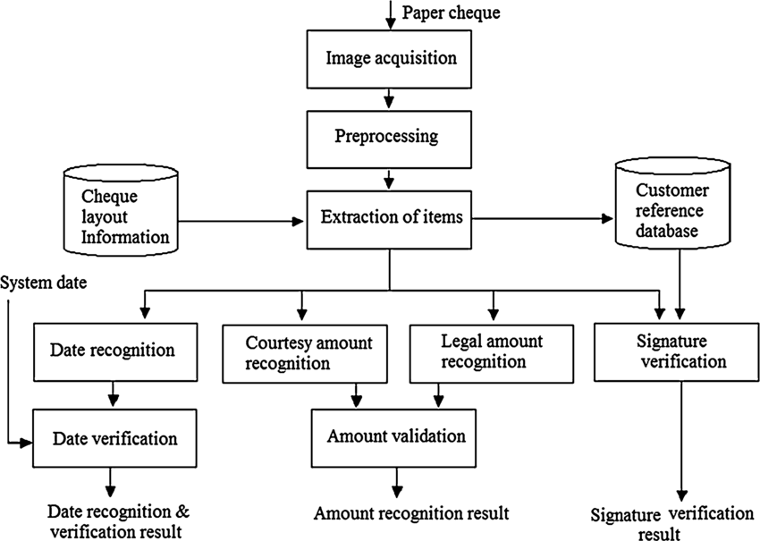
SCHEMA DIAGRAM

Slide 10
Thank You
Team member names:
NISHANTHINI T V
SUBIKSHA N
SURIYA B S
SRISUDHAN L

